Slide 1


Hand Sign Language Recognition
&
Predictive Text System
Davide D’Alessio 2006654
David Enache 1937781
Francesco Russo 2023348

Slide 2
Overview
Goal: Translate sign language into written text
Computer Vision for image processing using the OpenCV library
NLP for word prediction
Mixed dataset: Manually collected images combined with an existing dataset
ML model to recognize hand signs
Hand Sign Language Recognition
&
Predictive Text System
Pagina <number>

Slide 3
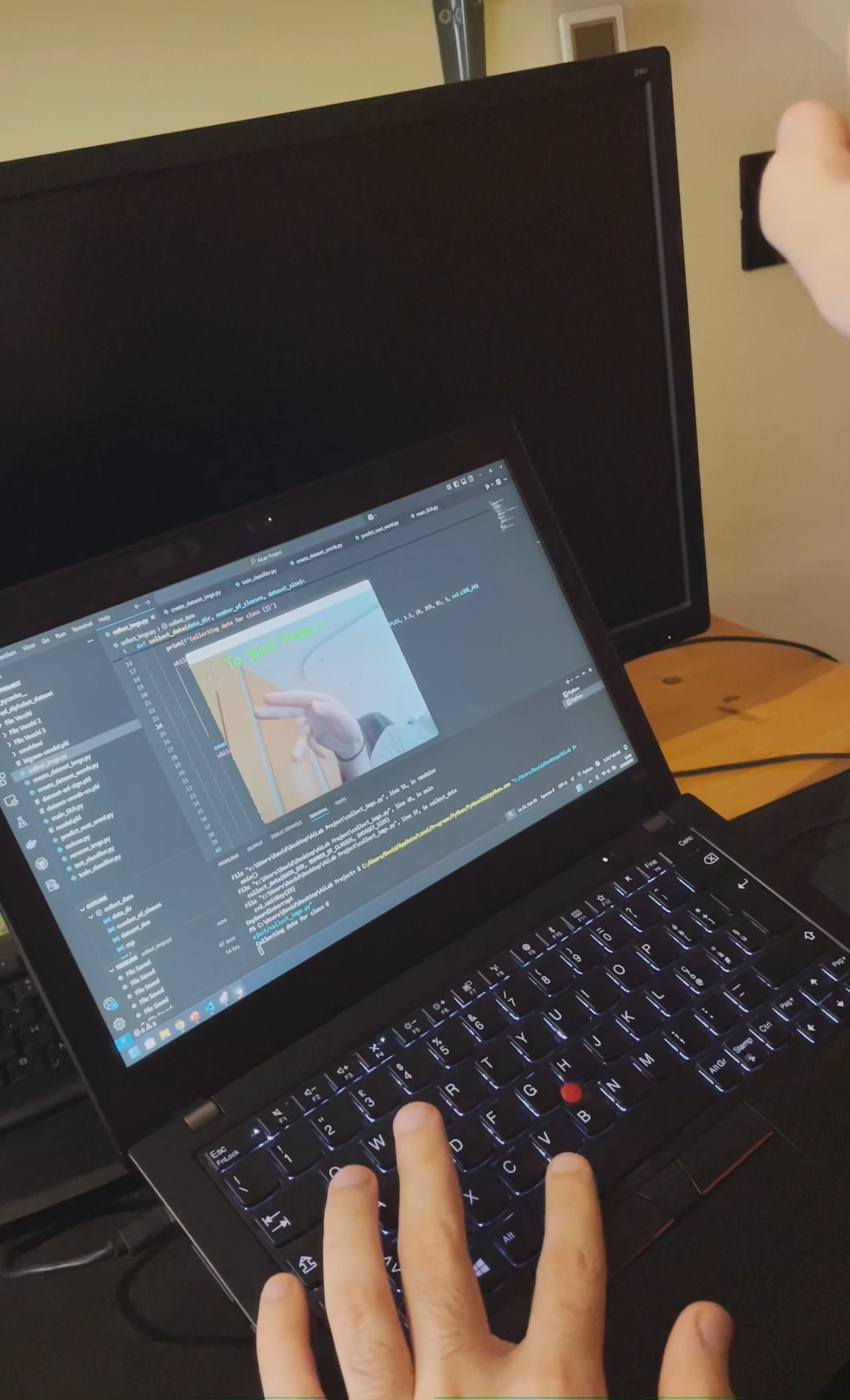
Collect Images
Dataset collection for training
For each letter:
  1500 images from existing datasets (www.kaggle.com/datasets/grassknoted/asl-alphabet/data)
  1500 manually captured images using a webcam
Addition of new signs for handling:
  Character deletion
  Space between words
  Wait sign
Hand Sign Language Recognition
&
Predictive Text System
Pagina <number>

Slide 4
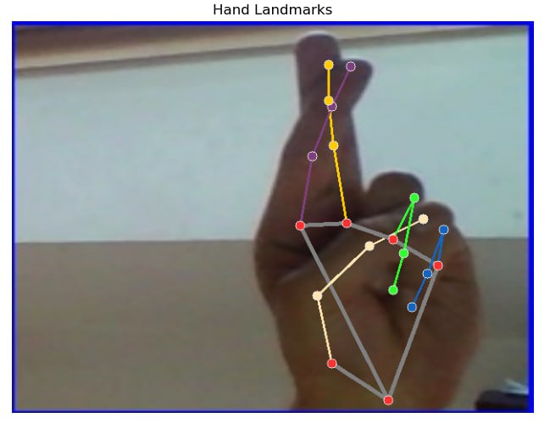
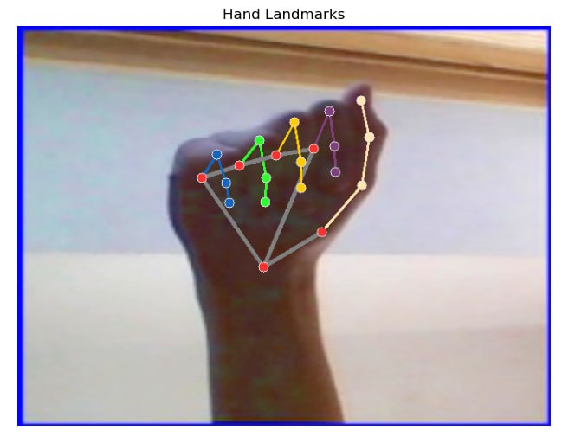
Create DataSet Images
Adjusted to a standard resolution of 640x480
Increased brightness if too dark
Flipped to capture the opposite hand
Image conversion using MediaPipe
Extraction of hand landmarks points
Data normalization based on hand distance
Saved in a binary file for training
Total photo: (3000x2)x29 = 174.000
Hand Sign Language Recognition
&
Predictive Text System
Pagina <number>

Slide 5
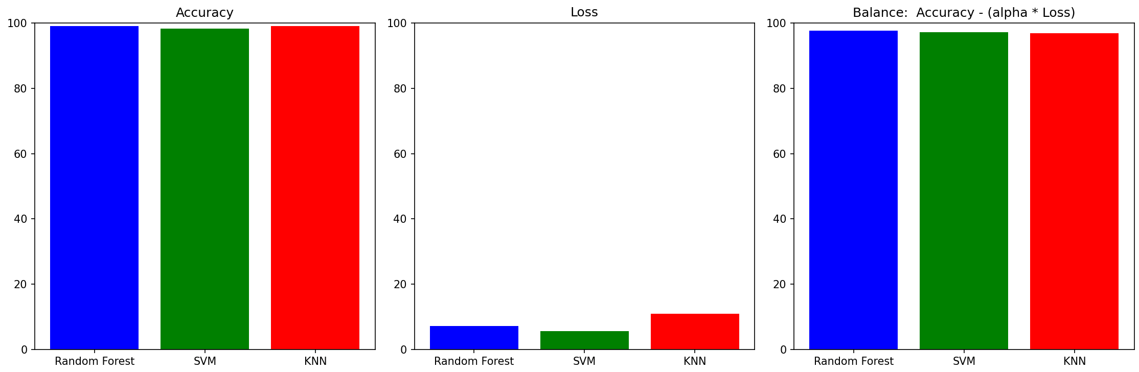
Training Models
We tested various machine learning models, Random Forest, SVM, KNN to determine the best fit for our task.
Model selection was based on evaluating both accuracy (the percentage of correctly classified signs) and loss (a measure of how far off the model’s predictions were from the true labels).
We chose the most balanced model, ensuring a trade-off between accuracy and loss, as a model with high accuracy but excessive loss would not generalize well to new data.
Results follow on the next page →
Hand Sign Language Recognition
&
Predictive Text System
Pagina <number>

Slide 6
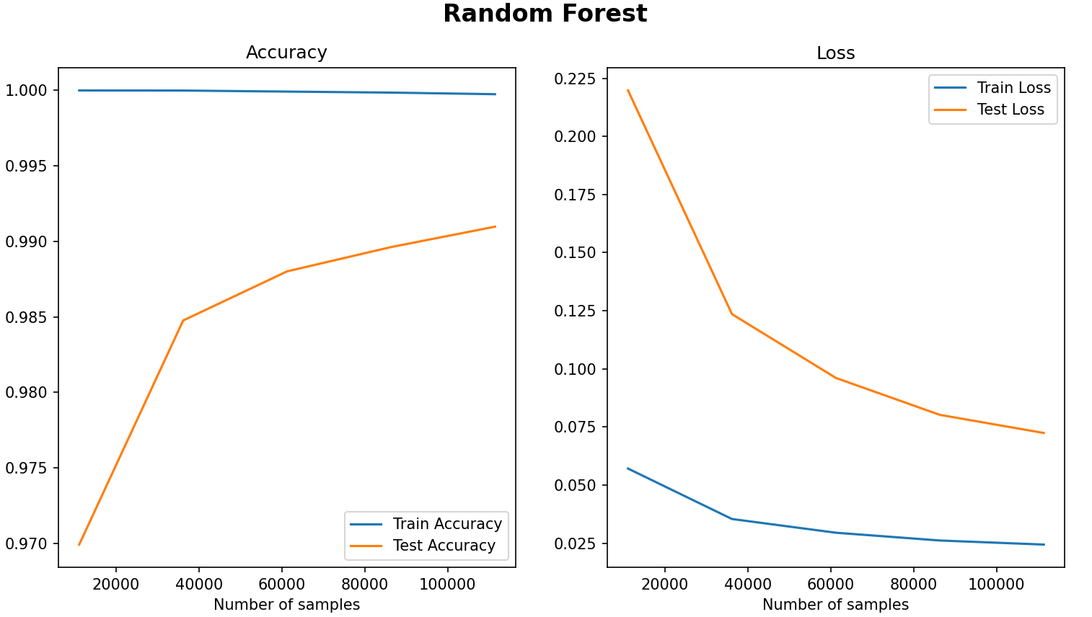
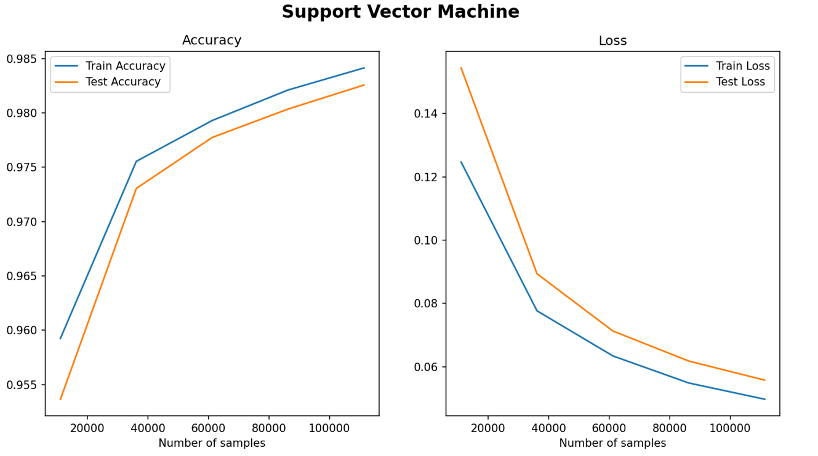
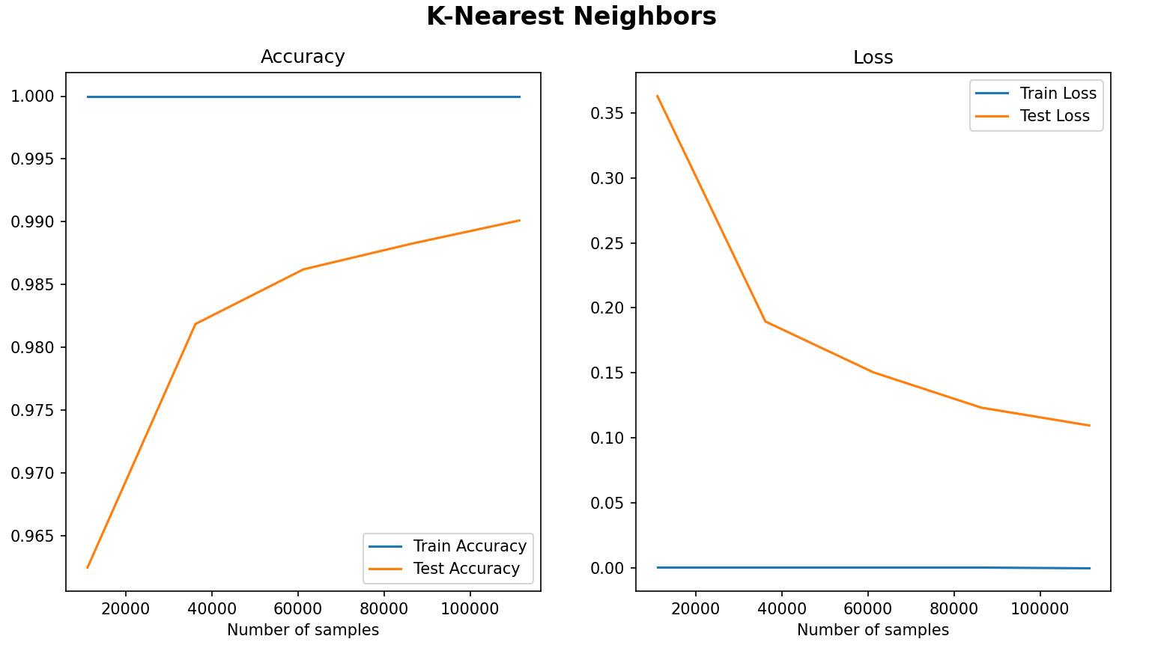
Results
Hand Sign Language Recognition
&
Predictive Text System
Pagina <number>

Slide 7
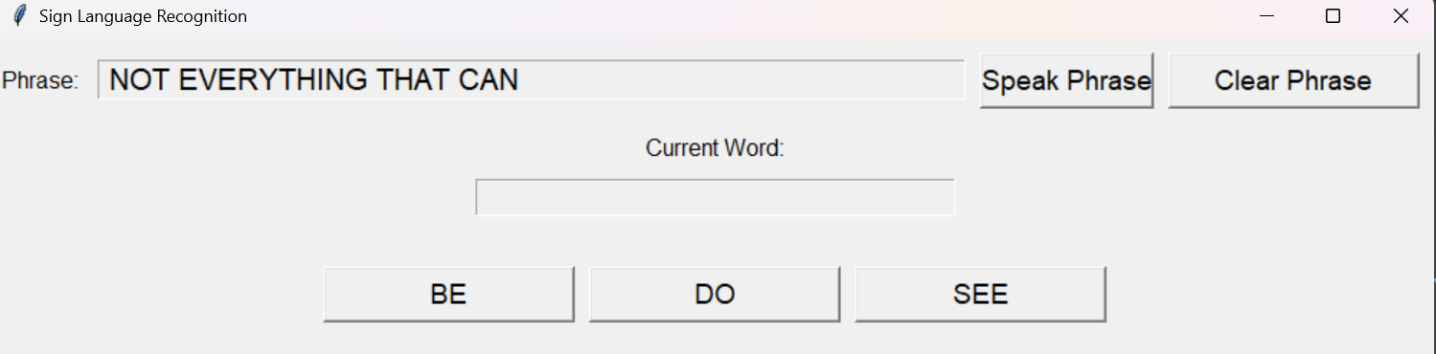
Word Prediction
Utilized NLTK libraries, including Brown and Word corpus.
Creation of the bigram model and dictionary stored separately in a binary file.
Prediction of the next word based on entered characters:
  Based on bigrams, if a word exists within the sentence.
  otherwise, a frequency-based dictionary is used to suggest words when no match is found with the bigram.
Hand Sign Language Recognition
&
Predictive Text System
Pagina <number>

Slide 8
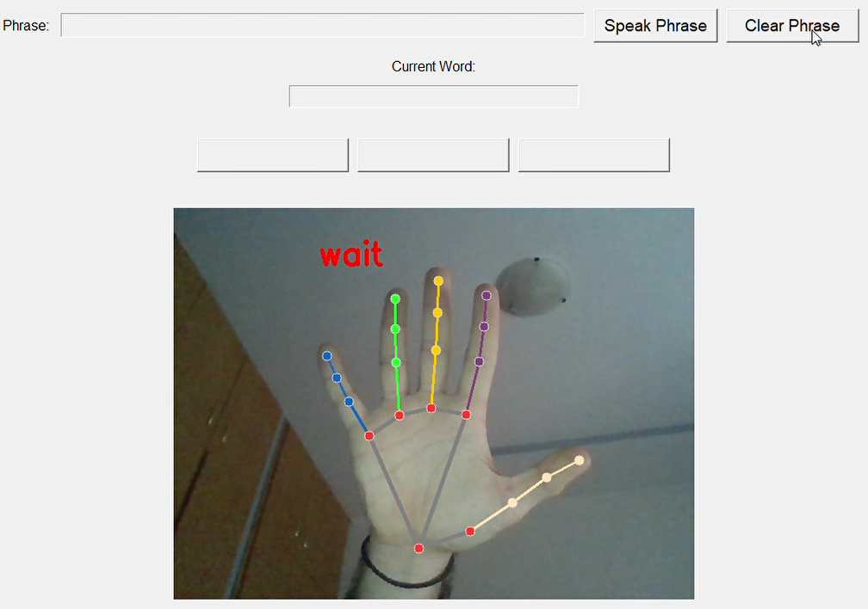
GUI
Libraries used: Tkinter, pyttsx3, PIL.
A graphical interface for converting ASL to text.
A display field for showing sentences or words.
Buttons for clearing input and speaking the current phrase.
Word suggestion buttons for providing 3 possible word predictions.
Hand Sign Language Recognition
&
Predictive Text System
Pagina <number>

Slide 9
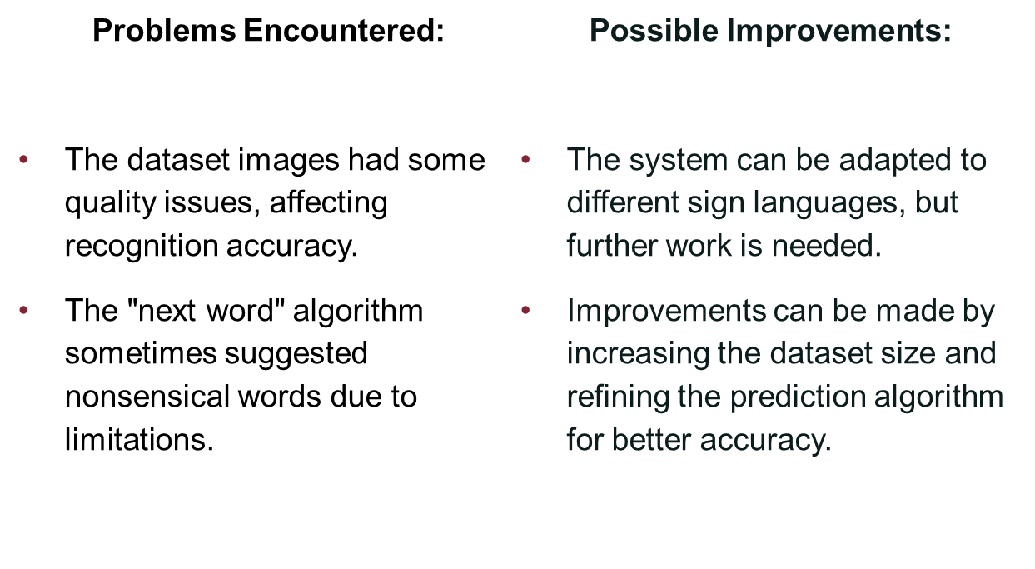
Conclusions
Hand Sign Language Recognition
&
Predictive Text System
Pagina <number>

Slide 10
Thank You
Davide D’Alessio
David Enache
Francesco Russo

